Slide 1



Slide 2


Agenda
Cloud Computing
Why it is used
Architecture
Different types of Service Models
Different types of deployment Models
Cloud Service Provider Companies
Benefits

Slide 3

Cloud computing
Cloud computing means storing and accessing data and programs over the internet instead of your computer's hard drive.
Using cloud computing,users are able to access software and applications wherever they need.

Slide 4
Why it is used
File storage: You can store all types of information in the cloud, including files and email.
File sharing: The cloud makes it easy to share files with several people at the same time.
Backing up data: You can also use the cloud to protect your files.

Slide 5
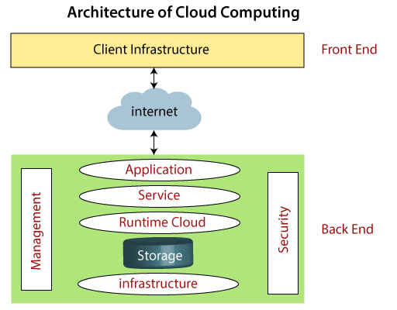
Architecture
Cloud computing architecture is divided into the following two parts
. Front End
. Back End

Slide 6
Components of Architecture
Client Infrastructure
Application
Service
Runtime Cloud
Storage
Infrastructure
Management
Security

Slide 7
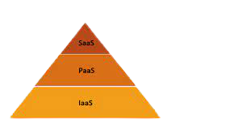
Service models
Cloud computing offers the following three type of services:
Software as a Service(SaaS)
Platform as a Service(PaaS)
Infrastructure as a Service(IaaS)

Slide 8
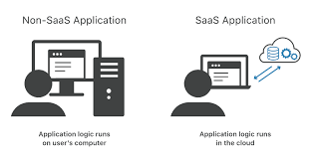
SaaS:
It is also known as cloud application services.
It works through web browsers.
Example: Google Apps, Salesforce Dropbox, Slack, Hubspot, Cisco Webex.

Slide 9
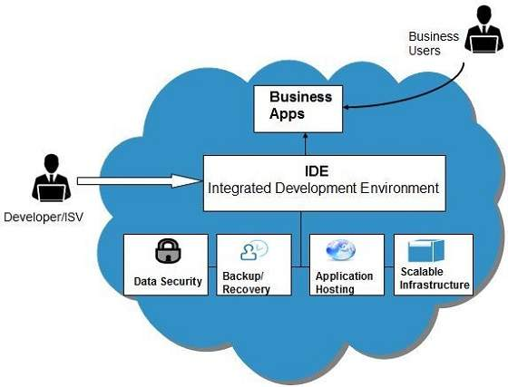
PaaS:
It is also known as cloud platform services.
PaaS provides a platform for software creation, but using SaaS, we can access software over the internet without the need of any platform.
Example: Windows Azure, Force.com, Magento Commerce Cloud, OpenShift.

Slide 10
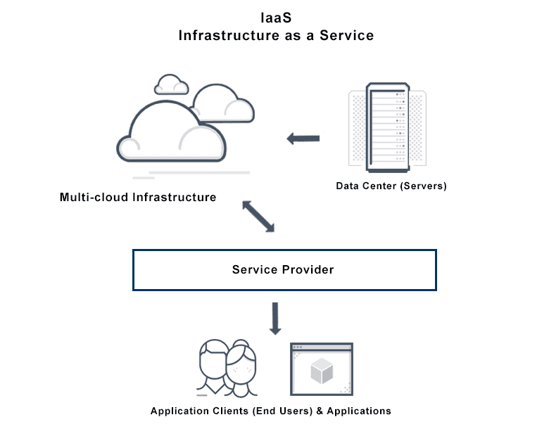
IaaS:
It is also known as cloud infrastructure services.
It is responsible for managing applications data, middleware, and runtime environments.
Example: Amazon Web Services (AWS) EC2, Google Compute Engine (GCE), Cisco Metapod.

Slide 11
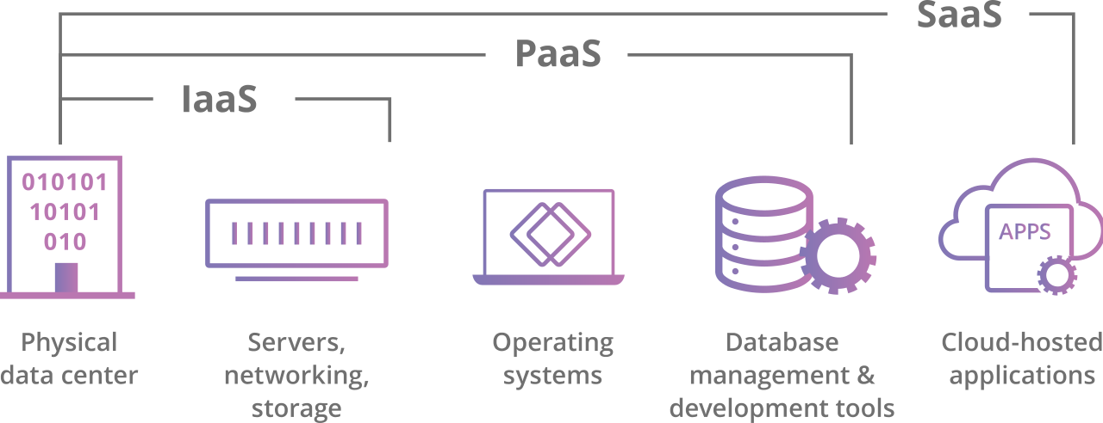
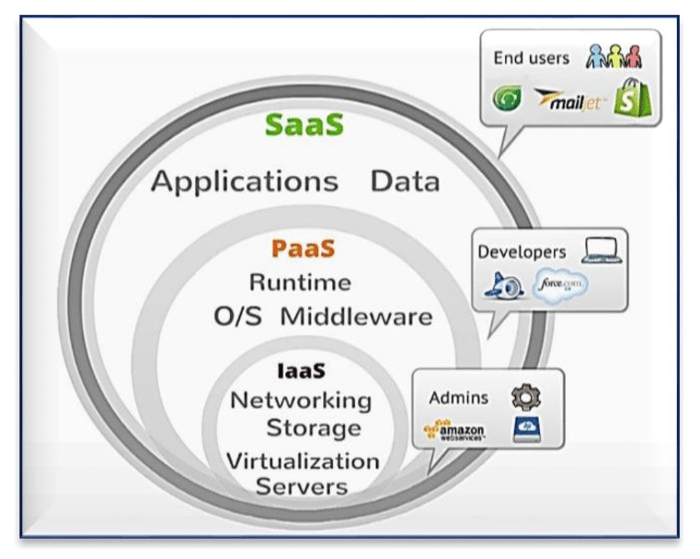

Slide 12
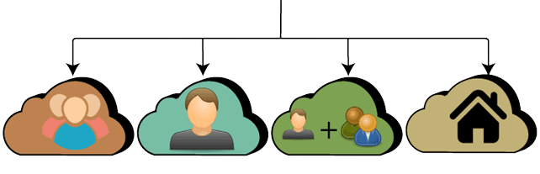
Deployment Models
TYPES OF CLOUD
Public
Private
Hybrid
Community

Slide 13
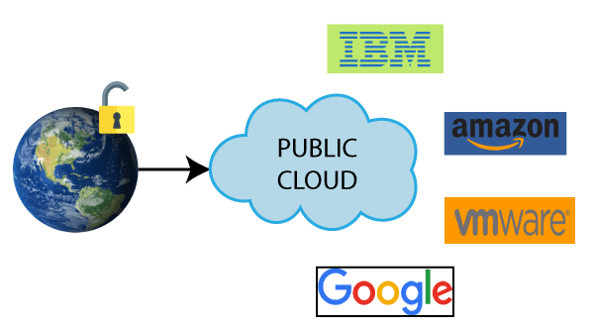
Public Cloud:
Public Cloud provides a shared platform.
Public cloud operated on the pay-as-per-use model.
The same storage is being used by multiple users at the same time.
Amazon Elastic Compute Cloud (EC2), Microsoft Azure, IBM's Blue Cloud, Sun Cloud, and Google Cloud are examples of the public cloud.

Slide 14
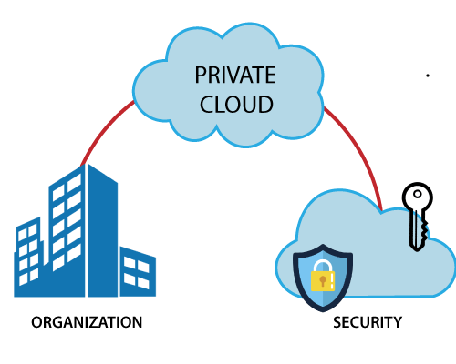
Private Cloud:
Private cloud is also known as an internal cloud or corporate cloud.
Private cloud provides computing services to a private internal network.
Private cloud provides a high level of security and privacy to data.
HP Data Centers, Microsoft, Elastra-private cloud, and Ubuntu are the example of a private cloud.
Organization
Security

Slide 15
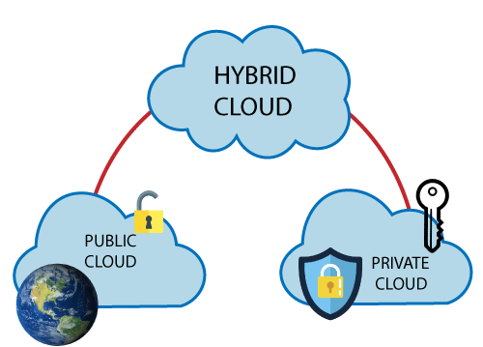
Hybrid Cloud:
Hybrid cloud = public cloud + private cloud.
The aim to combine these cloud (Public and Private) is to create a unified, automated, and well-managed computing environment.
Hybrid cloud is used in finance, healthcare, and Universities.
The best hybrid cloud provider companies are Amazon, Microsoft, Google, Cisco, and NetApp.

Slide 16
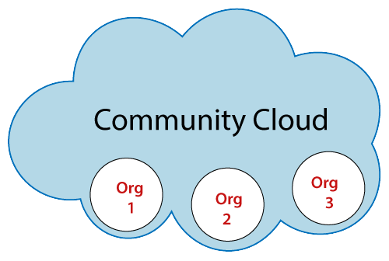
Community Cloud:
Community cloud that allows systems and services to be accessible by a group of several organizations to share the information.
It is owned, managed, and operated by one or more organizations in the community, a third party, or a combination of them.

Slide 17










Cloud service provider companies
Amazon Web Services (AWS)
Microsoft Azure
Google Cloud Platform
IBM Cloud Services
VMware Cloud
Oracle cloud
Red Hat
DigitalOcean
Rackspace
Alibaba Cloud

Slide 18

benefits
Back-up and restore data
Improved collaboration
Excellent accessibility
Low maintenance cost
Mobility
IServices in the pay-per-use model
Unlimited storage capacity
Data security

Slide 19
references
https://www.javatpoint.com/cloud-computing-tutorial
https://www.cloudflare.com/en-in/learning/cloud/what-is-the-cloud/
https://www.geeksforgeeks.org/cloud-computing/
https://www.w3schools.in/cloud-computing/cloud-computing/

Slide 20


